Slide 1
Sutherland’s Digital Assurance Services Driving Excellence for Verizon

Slide 2
Sutherland’s E2E Digital Assurance Services
Holistic Assurance Across Business & Technology Services
Digital Assurance Advisory Services
DA Maturity Assessment
DA Maturity Enhancement
Managed Digital Assurance Services
Digital Assurance as a Service (e2e TaaS)
Test Automation Services (Cloudtestr)
Test Automation Services (BOT on Third Party tools)
Functional Quality Assurance Services
Functional Testing
Regression Testing
Migration Testing
Integration Testing
Omnichannel Experience Testing
Technical Quality Engineering Services
E2E Cloud Assurance
Performance, Scalability & Reliability Testing
Accessibility & Compatibility Testing
Device Testing
Operability Testing
Security Testing
Compliance & Regulatory Testing
Digital
Assurance
Services
Digital Assurance Launch Readiness Services
User Acceptance Testing
Business Readiness Testing
Operational Acceptance Testing
Digital Assurance Support Services
Test Environment Management
Test Data Management (GenRocket)
Operations Handover & Acceptance Training

Slide 3
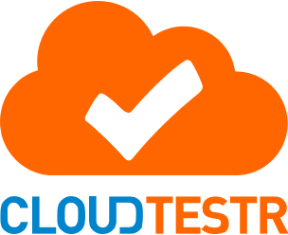










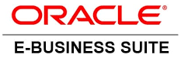






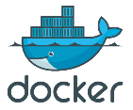


CloudTestr: Enterprise Automation Platform powering Verizon Value Business
Release Validation Partner
Automated Test Case (In-Sprint)
TaaS Delivery model
Test Management, Reports & Metrics
Sutherland Labs
Continuous Testing Platform
Modular Testing & Auto Scaling
Script-less Automation Solution
Change Management & TDD
Application Under Test (AUT)
SaaS
On-Premise
Web/Mobile
Integrations
RESTful, SOAP
APIs
OIC
Fusion
Batch Jobs
Enterprise Service Bus
Testing Types
Functional & Regression
Integrations Testing
End to End Testing
Performance Testing
Security Testing – Modular Testing
01
Enterprise QA Platform
02
Script-less TaaS
Solution – Business & IT
03
Hosting on Cloud or On-premise
04
Easy to develop, maintain, execute tests
05
High ROI, Test Coverage, Quality

Slide 4
Quality Engineering Journey @ Verizon
  Complete Services and MS migration into Script-Less Framework
  CI/CD integration of Script-Less Framework
  Start Pega campaign automation
Pilot Project (611611)
  Complete Web automation migration into Script-Less Framework
Automate Defect creation process upon Test suite execution
  Support daily releases*
Next Generation Automation (AI/ML)
Automation testing resource optimization
2021 Q4
2022 Q3-Q4
2023 Q1-Q2
2023 Q3-Q4
2024 Q1-Q2
2024 Q3-Q4
2025 Q1-Q2
  Build automation @ 2X speed using Script-Less Framework
  Enable script execution @4X speed
  In-sprint automation
Increase automation coverage using functional testers
Democratize automation including dev and business teams
Business case and initiate the pilot project (service automation)
  Intelligent platform that provides traceability metrics and supports compliance aspects
Automated test data management (GenRocket)
Enable Functional testers on Script-Less Framework
  Continue to train functional team to automate scripts

Slide 5

CloudTestr: Key Features Driving our Prepaid Value Success
Platform as a Service
Subscription & Consumption Based Pricing
Pre-built Test Cases for Packaged Applications
Enterprise Automation Platform – SaaS, On-Prem, Web, Mobile etc.
Quality Metrics Dashboard
Automated Test Data Management
On-boarding in 6-8 weeks & <5 days execution
Auto Health Checks – Process or Security breakdowns
Performance Testing
Auto Generation of Test Documentation
Modular Testing Capability
Integrate with CI/CD Pipeline
Integrations – Services & Microservices Automation
Auto Scale– Containerization
Test Driven Development and In-Sprint automation capabilities
Key Features
CloudTestr Platform

Slide 6


CloudTestr @ Verizon – New Enhancements (In-progress)
AI Features
Analysis Features
AI Driven Test Case Generation
Enhanced Defect Analysis and Reporting
AI Driven Test Case Maintenance
Predictive Analytics for Test Optimization / Risk Based Testing
AI Powered Self-healing Capability
Automated Root Cause Analysis
Intelligent Test Execution (Chatbot based interaction)
Enhanced UI Design

Slide 7
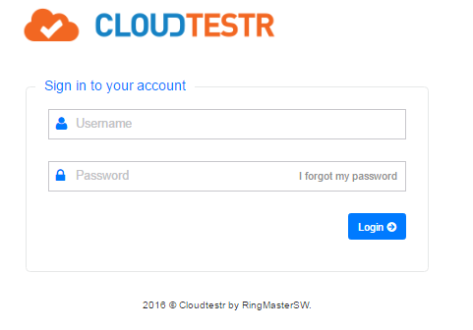
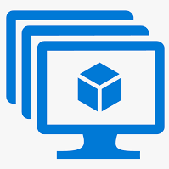

Verizon Value Automation/Integration - Architecture
Channels
Tools Integration
Front End Testing
Back End Testing
( REST/SOAP Services )
Database (4)
(Data Generation & Validations)
BRM
Oracle – CLYFY
IBM DB2
Postgres
CI/CD Pipeline - Jenkins
On Demand
Scheduled (Cron Jobs)
Release Code Commit
WEB (8)
Angular – SM, WFM
AEM – ST, TW, TF
IBM Portal – GS, Safelink
HCL Commerce
Retailer (3)
Walmart
Target
BestBuy
Dealer (2)
Incomm
Tcetra
TAS (Oracle ADF)
Test Management
Xray
qTest
CloudTestr Database
CloudTestr Portal
On-Demand Run
Scheduled
SMS (1)
611611
Container Host VM’s
Middle Tier (4)
Microservices (Spring boot + k8s )
SOA
CBO
SpringFarm
( Test Results Published with reports, Dynatrace URL attached to each run )
Debugging Failures
Dynatrace
Containers in host VM
Accessibility Testing
Evinced

Slide 8
CloudTestr @ Verizon - Overview
PRODUCT FEATURES
CloudTestr
@ Verizon
Outcome
TOOLS INTEGRATED
CloudTestr
@ Verizon
Outcome
Functional Tester can automate (No Technical Skill Needed)
Identify vulnerability in every scripts for the respective functional test
Scriptless – No Code Platform
Dynatrace – Tracing logs for application errors
Reusable Methods & Integrated TDM Solution (GenRocket)
Modularized scenarios with automated test data
Evinced – Accessibility testing
Automated accessibility testing and report
Retry Logic – Failed cases retry automatically
Un-attended execution for automation
Xray & QTest – Test management tools
CI/CD Integrated for continuous testing
Verizon specific custom functions – Ex: Tax calculations
Ability to add custom functions into the platform
AWS – Hosted in Verizon AWS & CI/CD Integrated
With in Verizon network and approved as VAST
Execution in containers
480+ Containers can be launched for execution
Docker Integration
Dockerization solution for optimal usage and cost if Infra

Slide 9
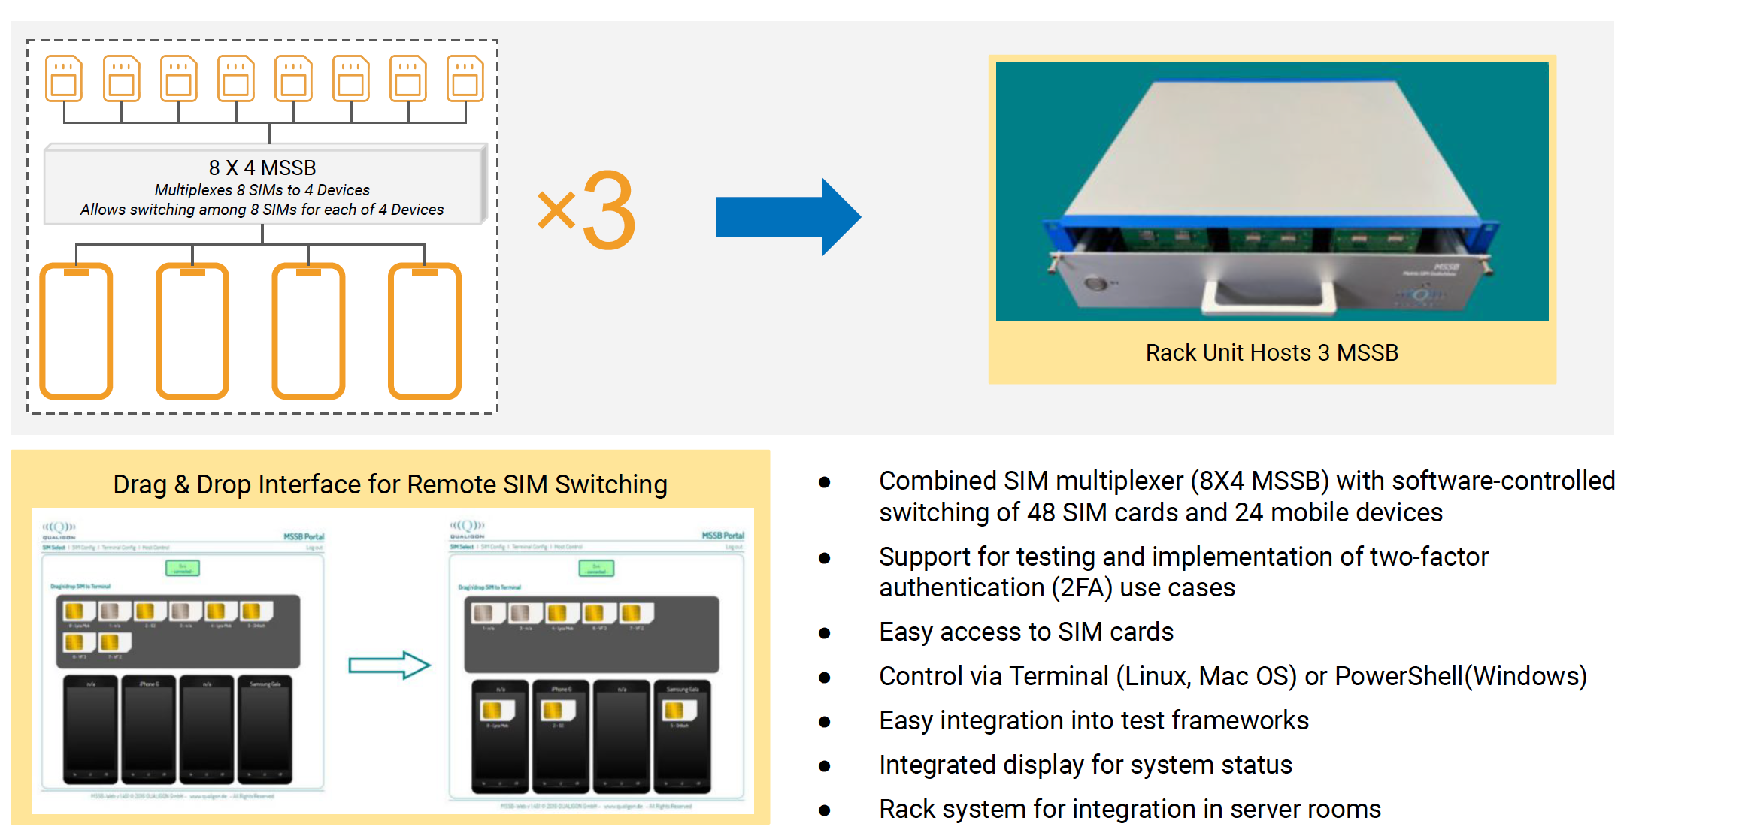
Headspin @ Verizon – Differentiator (SIM Switch)

Slide 10
Demo

Slide 12
Comparative Analysis
CloudTestr Vs Tosca
 |  | CloudTestr | Tricentis Tosca
Scripting Model |  | Script-less | Script-less (Model Based)
Ease of Implementation |  | Simple (Basic Training) | Complex (Certified Training Required)
Adoption & Scaling Across Enterprise |  | Technology Agnostic | Technology Agnostic
Total Cost of Ownership | License Cost | NA | $11,000 (Per User)
 | Implementation Cost | Existing Solution (Self-Funded Model) | High (Migration Cost Needed)
 | Support Cost | NA (Dedicated Support For Verizon) | Medium (Support Cost)
AL/ML Features |  | In-progress (ETA Feb’25) | Yes
Platform Customization |  | Yes (Verizon Centric Platform Customization) | No (General to all Customers)
Re-usable Assets |  | Yes (Assets for packaged applications for rapid deployment) | No
Notes:
Implementation cost by $
- What it would take to cost by 1000 TCs\
Feature comparison (Telco/Verizon)
Needs of Verizon (How CT Vs other tools)
Cost comparison
Feature that we build for Verizon (Already exist vs NOT available with other tool)
Value proposition for Vivek in testing space
Tell the story and create a value proposition
Convert the opportunity into reality
Don’t waste time in Tosca

Slide 13
Comparative Analysis
Key Features
 | CloudTestr | Tricentis Tosca
Automated Test Case/ Script Generation | In-progress (Future Release) | No
Scripting Development / Onboarding Speed | 2X | 1X
Script Execution Speed | 4X | 2X
Auto Scale / Container Based Execution | Docker Container Solution | Elastic Containers
Beginner-Friendly | Yes | No
Reusable Methods | Yes | Yes
Coding Skill Required | No | No
HAR File Generation for Analysis (Collecting HAR files for deep analysis of application behavior during testing) | Yes | No
Self Healing | Partial (Full Capability ETA – Feb ‘25) | No
Retry Failed Tests Automatically | Yes | NA
Test Creation Effort per TC | 2 Hrs | 5 Hrs
TC Maintenance Effort for each | 1 Hr | 2.5 Hrs

Slide 14
Comparative Analysis
Capability
 | CloudTestr | Tricentis Tosca
API Testing | Yes | Yes
Cross Browser Testing | Yes | Yes
Mobile Testing | Yes (Integrated with CT) | Yes
Bug Tracking Tools Integration | No | Yes
End-to-end Testing | Yes (Web & Service) | Yes
Risk-based Testing | Yes | No
Test Data Management | Yes (Integrated with GenRocket) | Yes (Stand Alone)
Service virtualization | Yes | Yes
Exploratory Testing | No | Yes

Slide 15
Comparative Analysis
3rd Party Integration
 | CloudTestr | Tricentis Tosca
CI/CD Integration | Yes | Yes
Version Control Tools Integration | NO | Yes
Bug Tracking Tools Integration | Yes (Integrated with CT) | Yes
Team Communication Integration | Yes | No
Test Management Tool | Yes (Qtest & Xray) | Yes (Qtest)
Selenium Integration | Yes | No
API Integrations | Yes - Open API Integration | Yes
Dynatrace Integration (Analyzing and identifying error flows within applications using Dynatrace) | Yes | No
Evinced (Accessibility Testing: Automated accessibility testing to ensure web content is accessible to all users) | Yes | No

Slide 16
Verizon QE – What Sutherland can offer?
Achievements Enabled
Migration & Maintenance of 6K+ cases
Verizon specific Customization & integration
Shift Left & Containerization
Proven Capabilities | Expanded Impacts | Assured Results
Unlocking Savings
Functional & Mobile Automation and Performance Testing (Produce more ROI)
200%
Uplift
~1M
savings
Innovation & Investments
Scriptless – No Code Platform
Reusable Methods & Integrated TDM Solution (GenRocket)
Invested around $935K in Verizon specific platform customization and migration
2X Productivity on Automation
(Can do lot more on automation development)
200%
Increased
$240K
savings
Assured Outcomes
Automation ROI around 2M+ per year
On-prem mobile lab benefits $350K
Infrastructure cost saving for automated execution is at $93K every year (Moved on-prem servers to containers)
4X Execution Speed (Give back saving from execution)
400%
Improvement
$250K
savings
Not needed so many manual testers by using automation platform
200%
savings
$900K
savings
Value Proposition
Script less Automation
Open platform for multi-party usage
Deeply integrated into Verizon ecosystem
Fully Compliant to Verizon processes/ WoW
ZERO Cost for Platform
Average QE Invoice Per Year = $11.04M ($0.92M per month)
Assured Saving in 2025 = $2.39 M
QE Invoice after saving = $8.39M

Slide 17
CloudTestr – Implementation Overview
Implementation
Effort
Cost
Investment From Sutherland
Outcome
Scripless automation platform – Functional Tester can automate
CloudTestr - Platform
-
$100K
2022
10 Months
(15 Resources)
$350K
One platform solution for all automation needs
Selenium to CloudTestr Platform
Investment Cost by Sutherland in 2022
$450K
Verizon Specific Enhancements
(Tool Integrations & Custom Functions)
2160 Hrs
$65K
Integrated solution – Customized for Verizon
2023
CloudTestr – Platform + Support
1 Year
$210K
No platform cost to Verizon & Dedicated support
Shift-Left & Container Solution
6 Months
$193K
Co-Invested
Container based execution for faster release cycle
Investment Cost by Sutherland in 2023
$275K
2024
CloudTestr – Platform + Support
1 Year
$210K
No platform cost to Verizon & Dedicated support
Investment Cost by Sutherland in 2024
$210K
Total Investment Cost by Sutherland - $935,000.00

Slide 18
CloudTestr – Implementation Overview
Implementation
Effort
Cost
Investment From Sutherland
Comments
CloudTestr - Platform
-
$100,000.00 / Year
No platform cost to Verizon
2022
Selenium to CloudTestr Platform
10 Months
(15 Resources)
$350,000.00
6482 TCs migrated including maintenance
CloudTestr Platform Support
$120,000.00
Dedicated support team for tool maintenance
2 Member Support Team
Verizon Specific Enhancements
(Tool Integrations & Custom Functions)
$65,000.00
Product DEV team support through the year
2160 Hrs
6 Months
$193,788.00
Co-Invested
Co-Invested by Sutherland & Verizon
Shift-Left & Container Solution
Total Investment Cost by Sutherland - $635,000.00

Slide 19

Verizon QE – What Sutherland can offer?
With automation focused solution – Sutherland will deliver assured cost saving of 20% from overall QE spend by end 2025 of which 10% can be re-invested in innovation and 10% will be returned as Opex/Capex savings
Current State
Future State Recommendations
TracFone
Visible
Integrated QE Organization
Script less Automation through CloudTestr
80% of regression automation coverage
2X speed of development compare against selenium automation
Regression Test Coverage: average of 50%-60%
Automation using Selenium (Web), Appium (Mobile), Rest Assured (API)
  Leverage unified test automation across value segment
  Accelerated 90%+ regression automation coverage in 12 months time
  Leveraging containerization ability for scalability in execution at 4x speed
Test Automation
Perf. Testing across environments (Integration, stage, production and mobile)
Performance testing with LoadRunner
  Explore tool optimization for performance engineering
  Potential to Increase the coverage of performance testing for every release
Performance Engineering
Cross functional QE team managed by CoE to optimize across multiple agile teams
Mobile testing with physical devices (Headspin Lab at TracFone)
As an average, every releases are supported by ~both manual testing and automation scripts
10 Agile PODs supporting E2E functional testing and 4 automation PODs
Mobile testing with Headspin cloud
  Unified CoE approach for optimized combined sprint planning at value segment
  Extend Headspin lab for new device testing to value segment
  Introduce in-sprint automation to reduce functional testing load
Functional Testing
QE Validation
(CI/CD, Chatbot Automation, & Security)
QE test automation framework seamlessly integrated with DevOps tools for CI/CD
Shift Left Initiatives to identify defects in the lower environment to decrease the release cycle timeline
Implemented ‘Google ChatBot AI supported by UiPath
Enhanced SQA & Process Maturity
  Unified TDD/BDD strategy across value segment
  Unified DevOps tools & integration as a future state for continuous testing
  Implement Shift-Left strategy across value segment
Highest Quality
Speed @ Test
Reduced Cost
Transform while perform
Centralized Operating Model / Governance

